Slide 1


Embedded System Design Lab
Game Design: Whac-A-Mole
Rentao Wan, Tianbo Liu, Song He
2021/06/08

Slide 2

CONTENTS
01
Overview
02
Game design
03
S & H Codesign
04
Q & A

Slide 3
Overview
Design a whac-a-mole game in Verilog, using VGA connection to display the whack-a-mole game in a screen.
Press the start button, we can play the game through the matrix keyboard in a setting time (one minute), hitting the moles and getting scores
Write the score signal from the Processing Logic (PL) to the DDR in Processing System (PS), and then use the PS read the data. Finally display the real-time game score in the computer screen through the UART port.

Slide 4
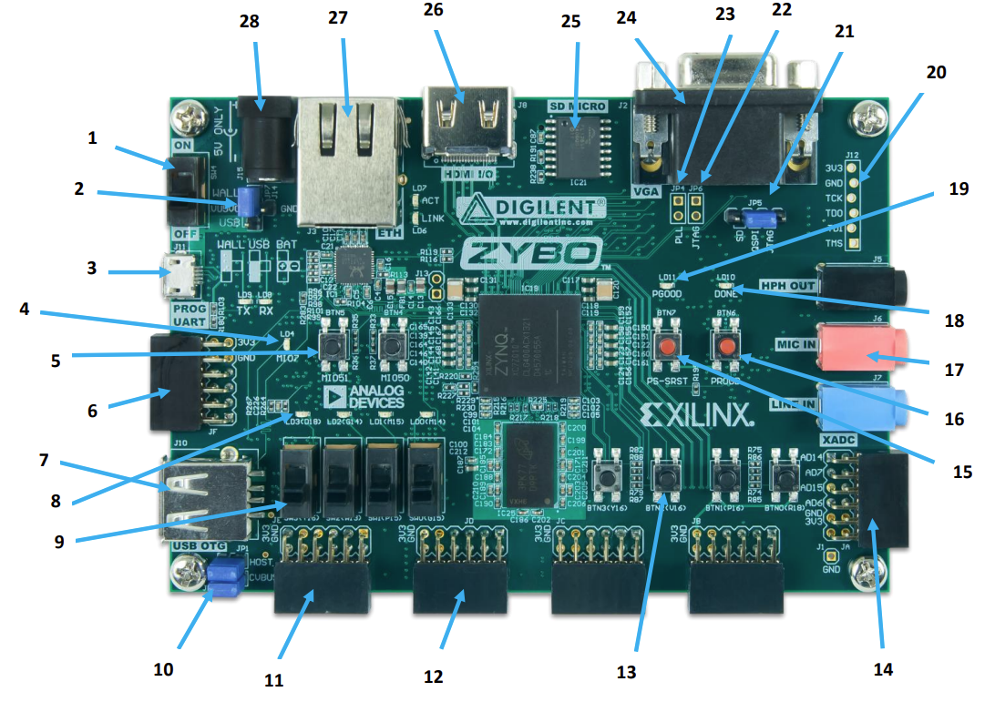
Design platform
ZYBO from DIGILENT
Notes:
Instead of using DE1 board, we use this board, as we can achieve our whole design with vivado.

Slide 5
Additional Design
Three different kinds of moles with different duration of appearance, corresponding to one score plus (Blue), two scores plus (Yellow), and two scores minus (Red).
A game full of randomness: random moles appear at random moments in random locations with random durations.
The game ends when the time countdown is over, or when the score is deducted to a negative number.

Slide 6
Block Diagram
Frequency
divider
VGA
color
Clock
Count
down
60s
No time
Vsync
debounce
Time
Vga
Display
Hsync
Start
Game
State
Game state
Binary to BCD
Mole
Control
Mole
Information
Reset
Scores
Add
Or
Reduce
Seg
keyboard
Segment
Display
Number
KeyBoard
Sel
Count
Scores
Negative
Scores
Notes:
I've read previous reports that basically everyone's games are written in C language and run on a soft core.
Our design is different.
The whole game is done through Verilog, including the VGA display of the real time game scenes（/siːns/） and simple flash

Slide 7
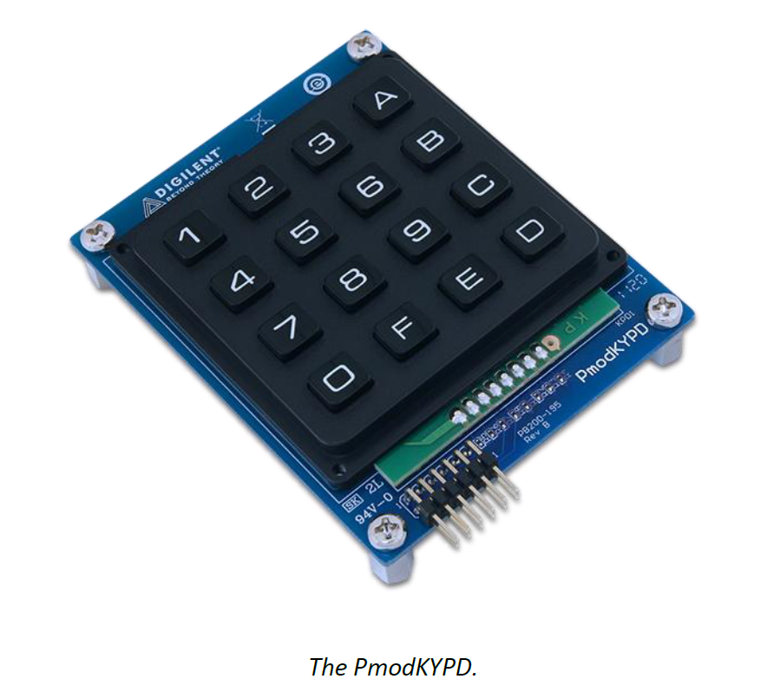
PmodKYPD
Output column scan signal and input the row scan results
Features:
Interacts with the system board through GPIO pins
16 individually labeled momentary push-buttons
Each set of rows and columns are isolated
Notes:
We use the matrix keyboard to control the hitting of moles.
There are 16 buttons, so we designed 16 locations for those moles
Through outputting column scan signal and inputting the row scan results, we can get the detail number.

Slide 8
Game State
There are four game states in the game: restart 00, game waiting to start 01, game in progress 10, game over 11.
clk_cnt <= 5
Waiting 01
Start signal
Reset
Restart 00
Reset
Reset
Gaming 10
Game over 11
No time/Negative
Notes:
There are four game states in the game: restart 00, game waiting to start 01, game in progress 10, game end11.
After pressing the start button, the game begins. Players play the game within 60 seconds, and if the score is lost, the game ends early

Slide 9
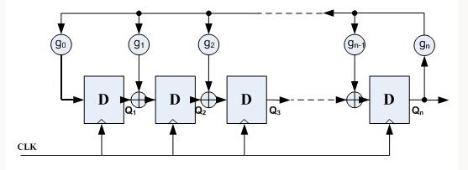
LFSR Random Number
As mentioned earlier, there are a lot of random behaviors in game design, and they are all based on the most basic pseudo-random numbers.
Notes:
The most common method to generate pseudo-random number is to use a linear feedback shift register (LFSR), which is composed of some D flip flops and several XOR gates.

Slide 10
Mole Control
The above random number generation is not really random
How to achieve better random effects based on those random numbers?
In the design, we use the human behavior to embed random effect.
Once the player press any buttons, the machine extract a number from a random sequence that loops over and over again. As the clock is so fast and the players press the buttons at random times, the selected number at this point can be considered as a truly random number !
Notes:
The above random number generation is not really random
How to achieve better random effects based on those random numbers?
In the design, we use the human behavior to embed random effects.
Once the player press any buttons, the machine extract a number from a random sequence that loops over and over again.

Slide 11
Mole Control
The details of the mole control are that:
The next mole is randomly assigned to the other location excluding where others kinds of moles may had already appeared.
The player can only hit a mole when the mole is during the appear time.
Hitting a mole will blacken it.
Noting that one mole cannot be hit twice.
Notes:
The above random number generation is not really random
How to achieve better random effects based on those random numbers?
In the design, we use the human behavior to embed random effects.
Once the player press any buttons, the machine extract a number from a random sequence that loops over and over again.

Slide 12
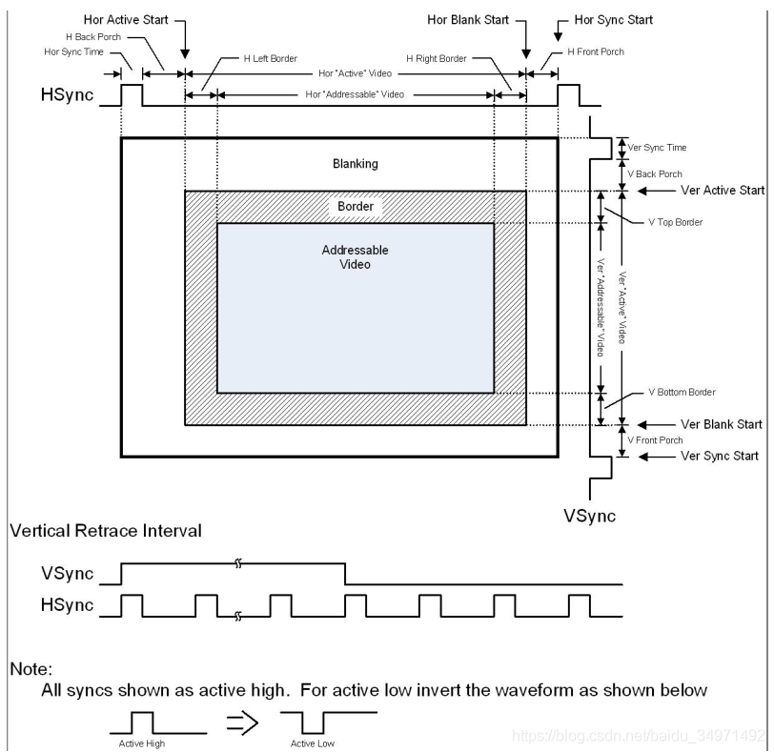


VGA Control
The clock frequency on the board is 125MHz，and it is converted to a 100MHz clock through a clock wizard IP.
General timing
Screen refresh rate | 60Hz
Vertical refresh | 31.32KHz
Pixel freq. | 25.056MHz
Notes:
Look at the table and screen。
We want to achieve the screen refresh rate in 60 Hertz in a screen with the size of 6 hundred and forty plus 4 hundred and eighty
After designing and calculating, the pixels frequency should be about 25 megahertz
It is easy to transfer from 100 megahertz to 25 megahertz.

Slide 13
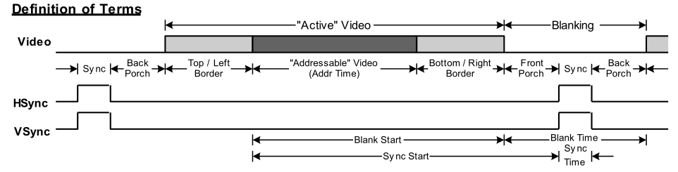
VGA Control
Horizontal timing (line) |  |  |  | Vertical timing (frame)
Scanline part | Pixels | Time [us] |  | Frame part | Pixels | Time [ms]
Visible area | 640 | 25.54278 |  | Visible area | 480 | 15.32567
Front porch | 16 | 0.638569 |  | Front porch | 9 | 0.287356
Sync pulse | 96 | 3.831418 |  | Sync pulse | 2 | 0.063856
Back porch | 48 | 1.915709 |  | Back porch | 31 | 0.989783
Whole line | 800 | 31.92848 |  | Whole frame | 522 | 16.66667
Notes:
We should show different colors in pixels in the scanline part and the frame part.
At other times, there is no color, which is used to do blanking

Slide 14
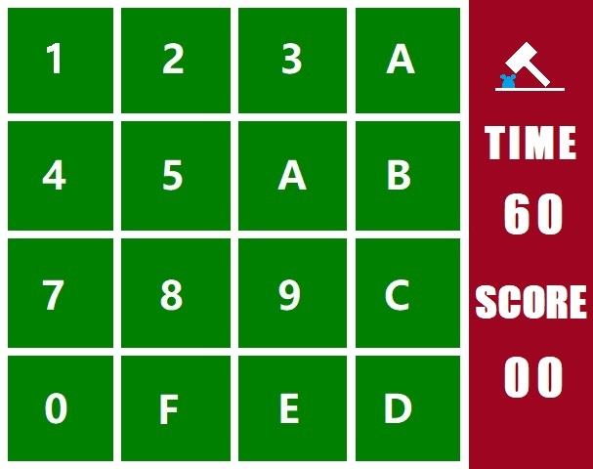
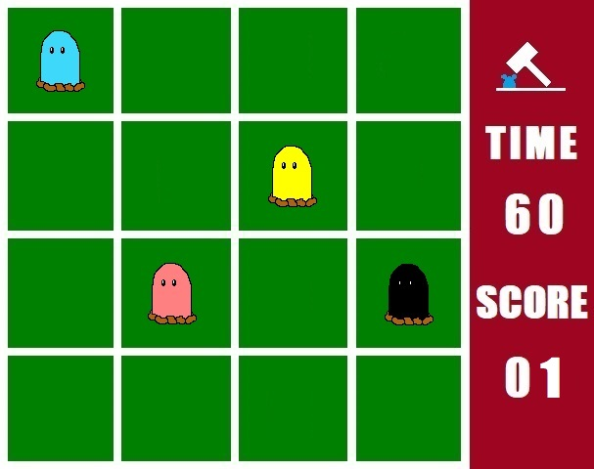
VGA Screen
Notes:
This is what we plan to show in the game

Slide 15




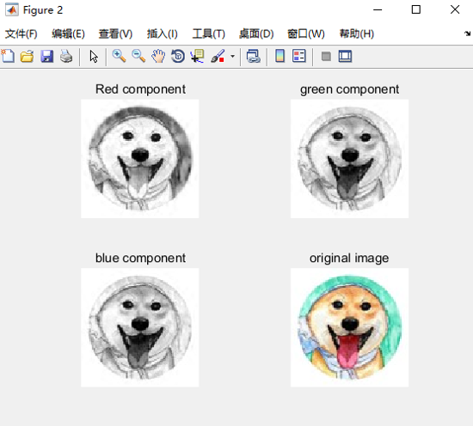




VGA Screen
Notes:
Matlab is used to generate the corresponding relationship between pixel position and color
We implemented the VGA display using combinatorial logic
Completing this module is a tedious and ‘delicate process

Slide 16
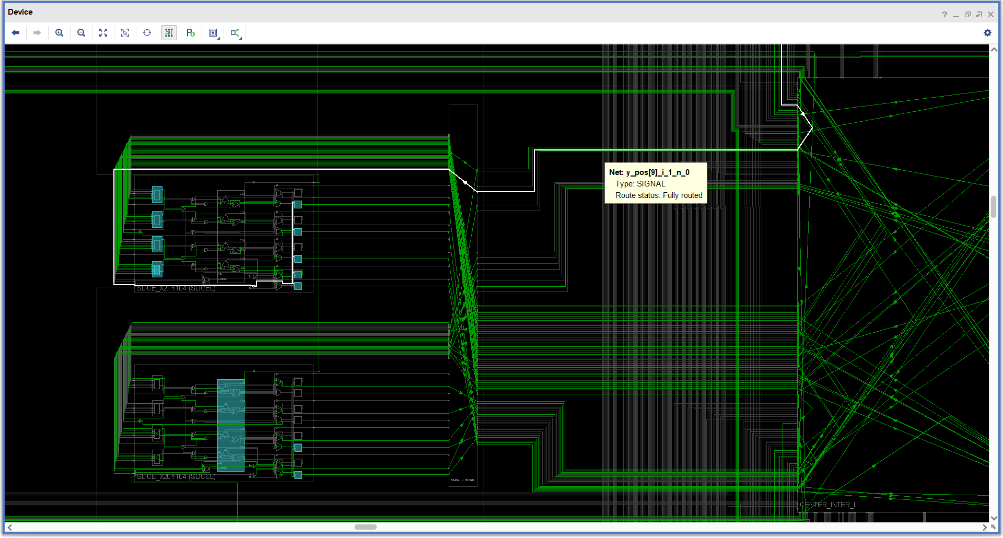
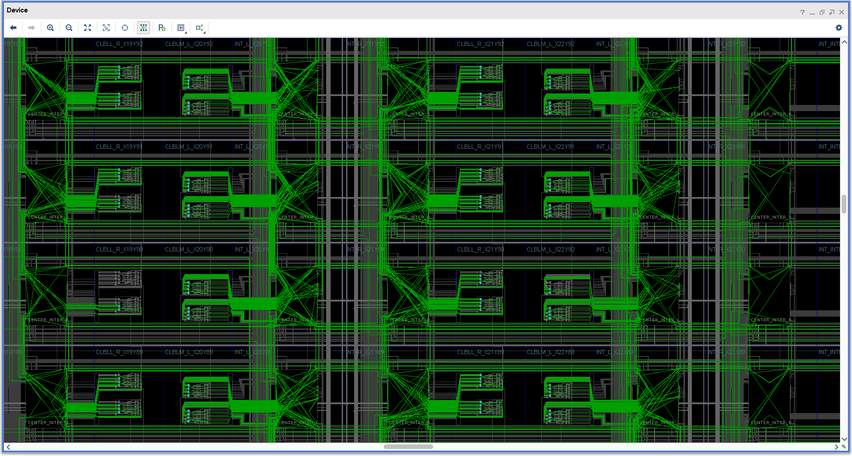
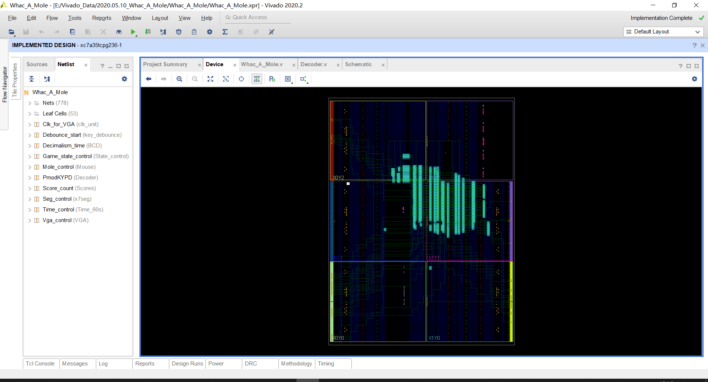
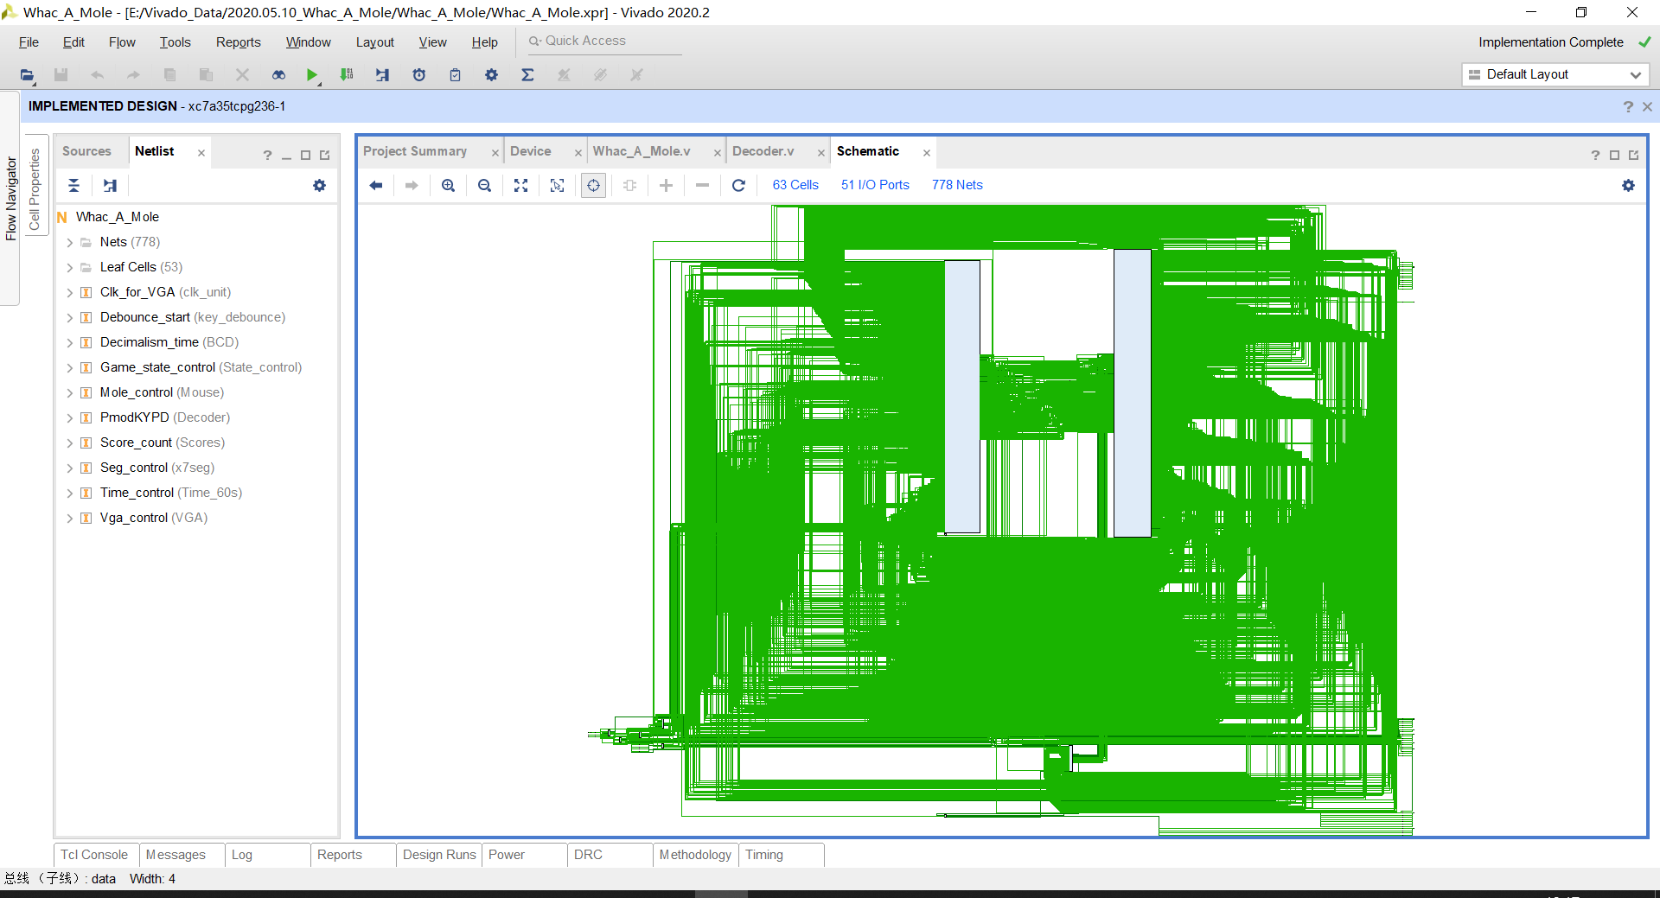
PmodKYPD
Notes:
As the VGA session uses too many look-at-tables
The overall layout and implementation are complicated

Slide 17
Design Report
Type | Power (W) |  |  | Utilization |  |  |  | Times (ns)
 | Dynamic | Device | Total | Slice | Logic | Flip-Flop | IOB | WNS
Snake | 0.063 | 0.072 | 0.135 | 1025 | 3521 | 480 | 51 | 2.407
Notes:
It looks pretty good, dynamic and static consumption is about the same, and the delay is not so bad.
But I am not sure whether the number of the logic is too big.
Anyway, I did implement the whole game in hardware

Slide 18
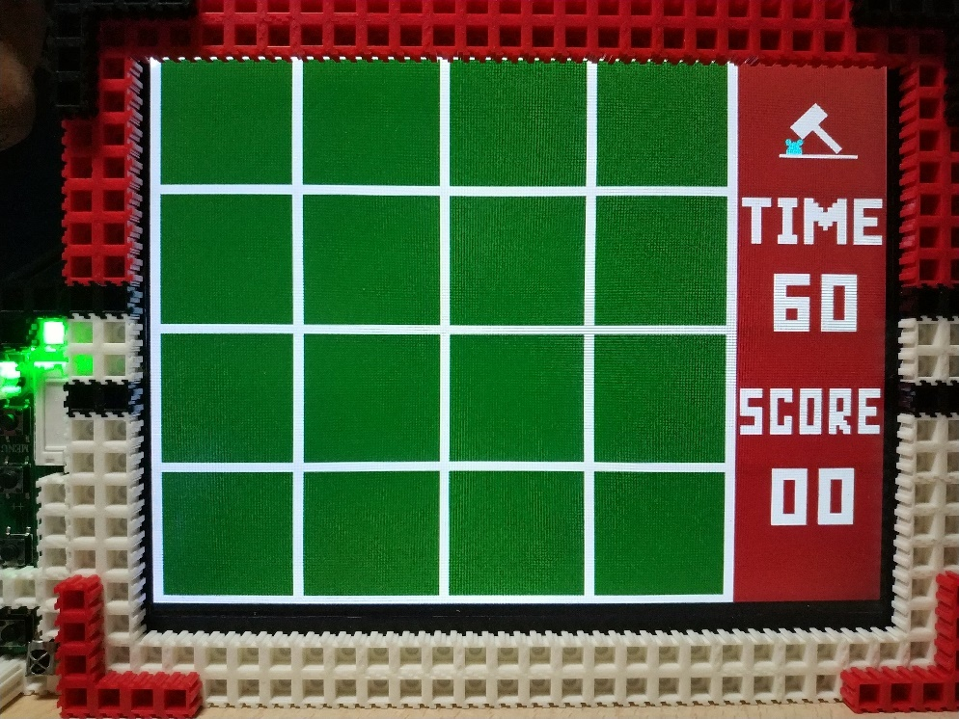
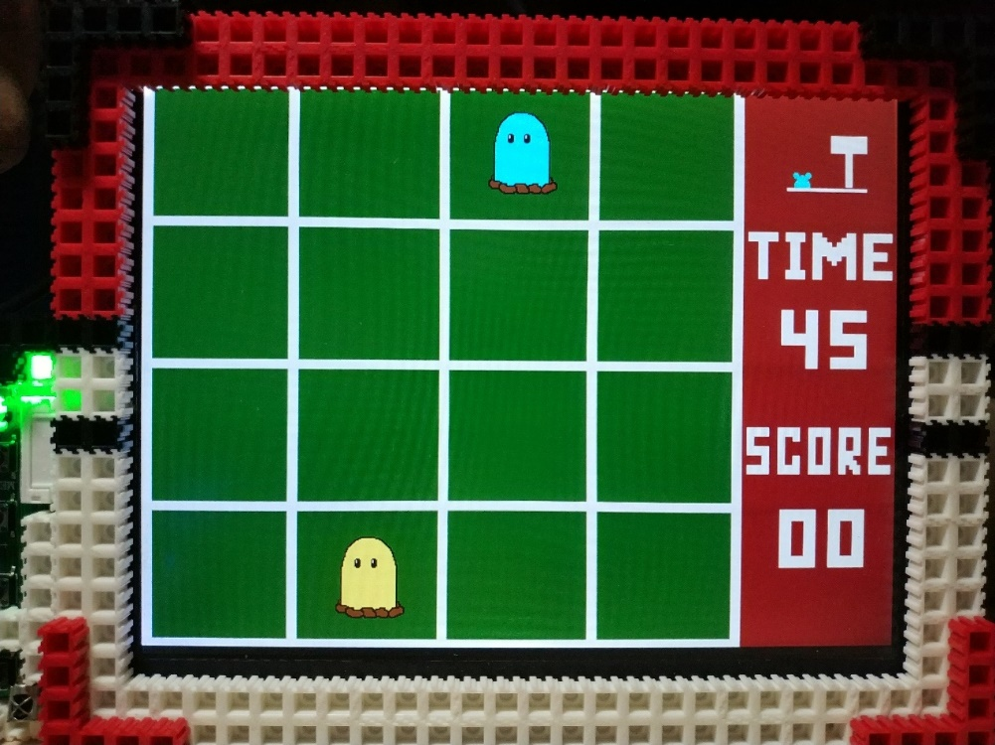
Gaming
Notes:
This is what the game looks like, pretty good, and it really meets the design goals

Slide 19
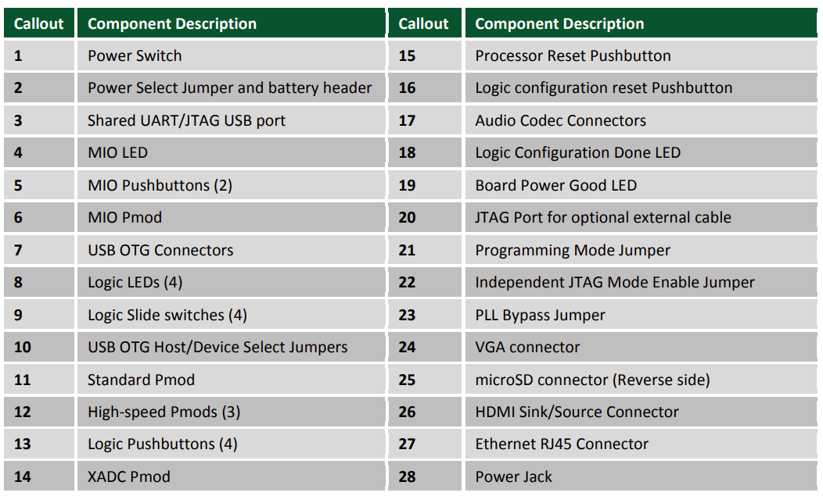

Development Board Introduction
ZYBO from DIGILENT
Peripheral Interface

Slide 20
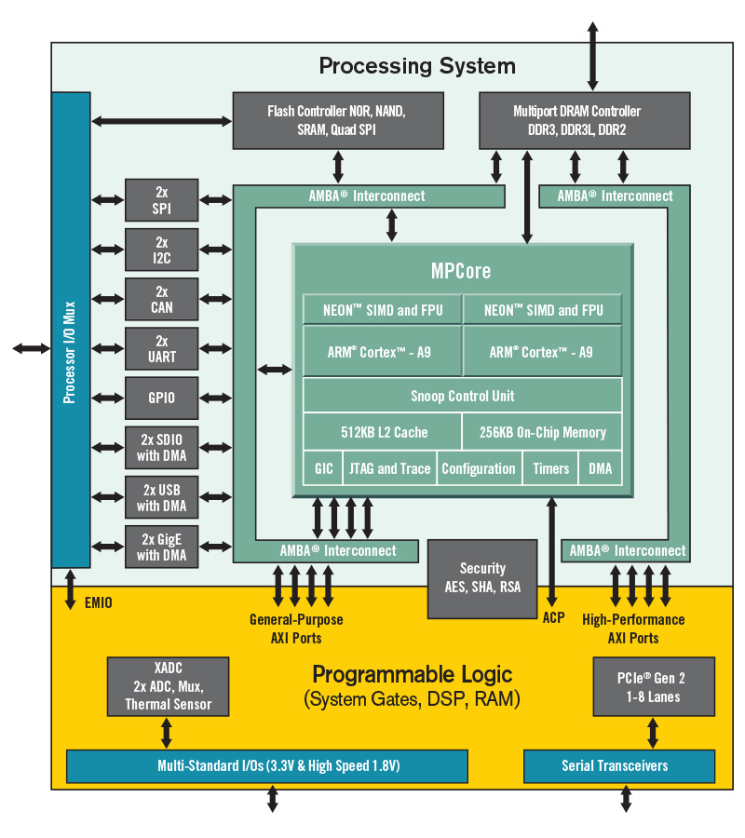
Chip Structure/Data Stream
GAME

Slide 21
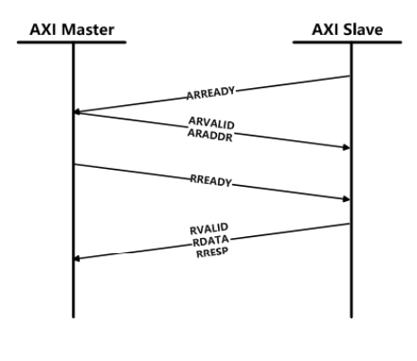
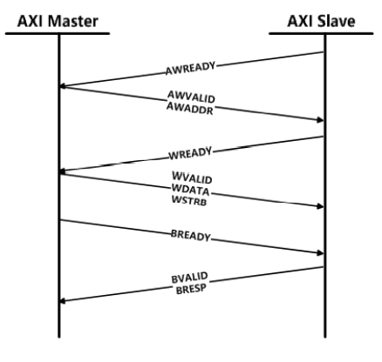
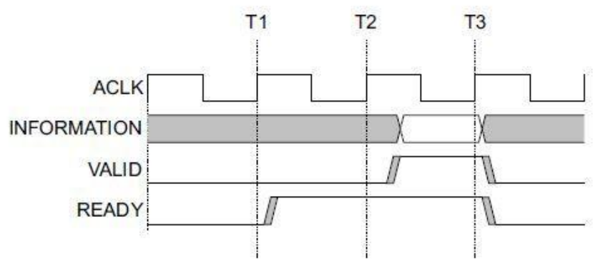
AXI Introduction
Ready
Valid

Slide 22
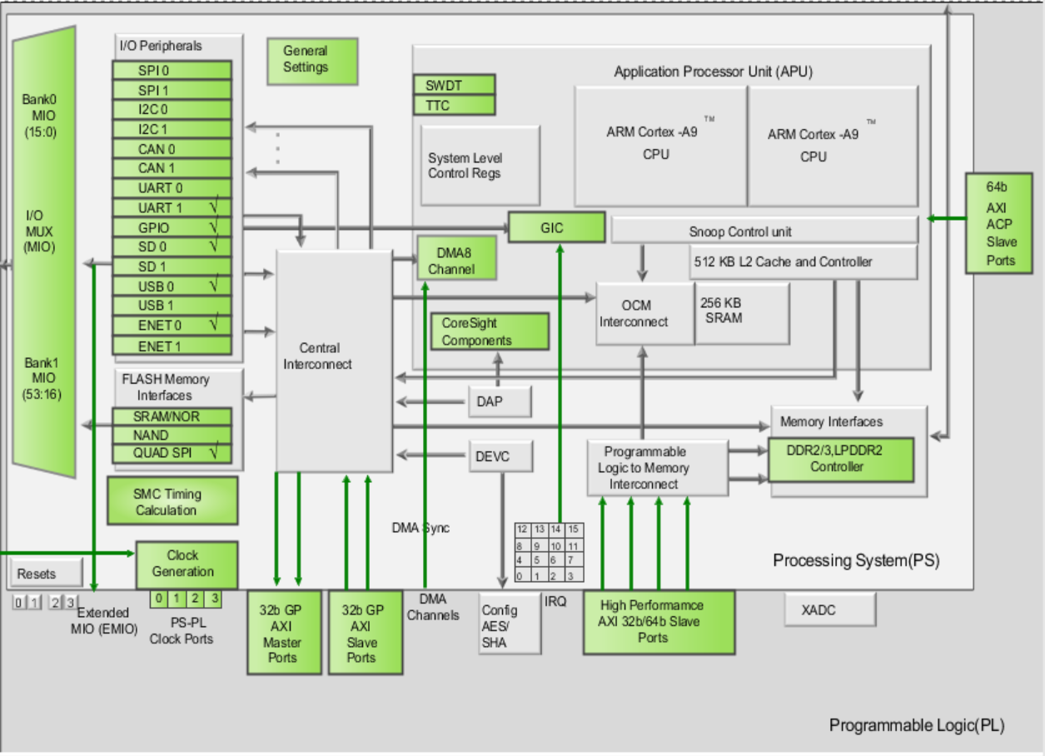
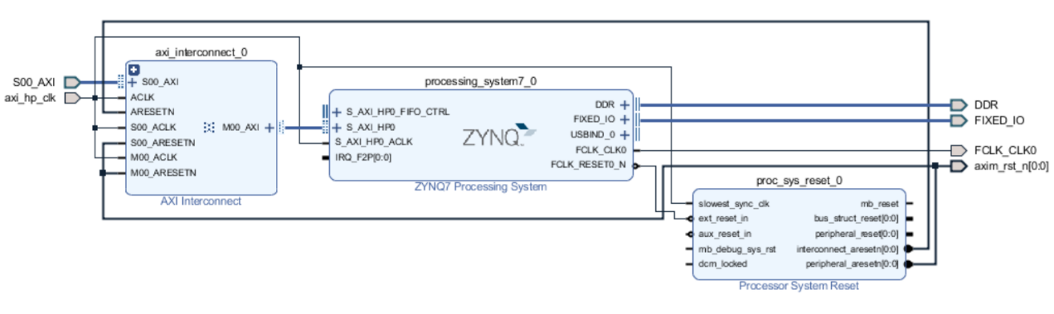
PS Setting
AXI4
AXI3
AXI3

Slide 23
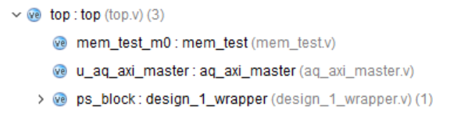
PL setting

Slide 24
C Code
#include "stdio.h"
#include "platform.h"
#include "xparameters.h"
#include "xil_printf.h"
#include "xil_io.h"
init_platform();
xil_printf();
Xil_In32();n

Slide 25
Problem
Sequential logic VS combinational logic
the slices are not enough.
VGA color design
RGB-888 Standard to RGB-565 standard
Notes:
At first we did most of the work in sequential logic, but during the implementation we failed. Because we were taking up too many resources, the slices are not enough.
so we covered most of the vga design in combinational logic with LUT
Then we have success.
At the beginning, we use the RGB-888 Standard, but the VGA chip in the FPGA board only supports 16 bit color
With 5 bits each for red and blue and 6 bits for green, 65,536 (32×32×64) different colors can be displayed, one for each unique 16-bit pattern.
So we have to change the 24bit color into 16bit color.
It is not simple, as if we only choose high bit data, there will be image distortion.
So we use the compensation algorithm to adjust the color.

Slide 26
Problem
AXI protocol
Virtual address

Slide 27


THANKS
name yyyy/mm/dd

